Slide 1
Azure OpenAI Service

Slide 2
Brief history of AI
Artificial Intelligence
Artificial Intelligence
the field of computer science that seeks to create intelligent machines that can replicate or exceed human intelligence
1956
Machine Learning
Machine Learning
subset of AI that enables machines to learn from existing data and improve upon that data to make decisions or predictions
1997
Deep Learning
Deep Learning
a machine learning technique in which layers of neural networks are used to process data and make decisions
2017
Generative AI
Create new written, visual, and auditory content given prompts or existing data.
Generative AI
2021

Slide 3
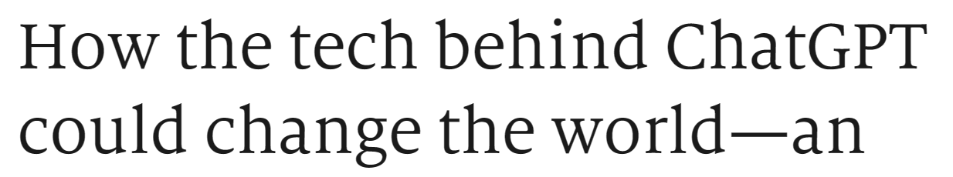
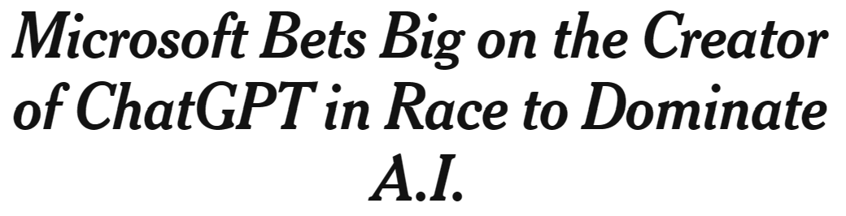
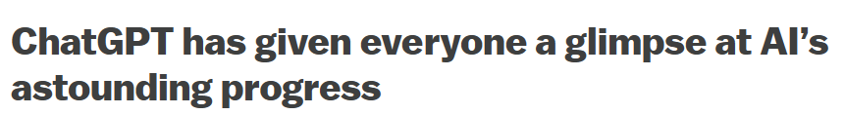
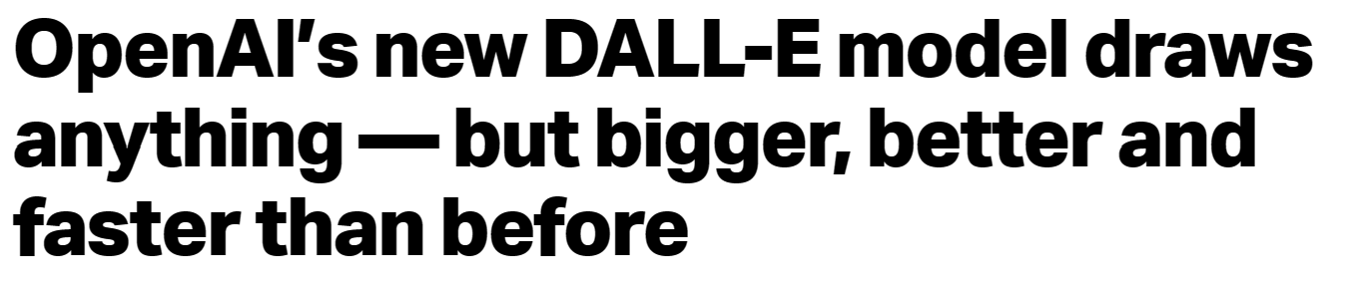
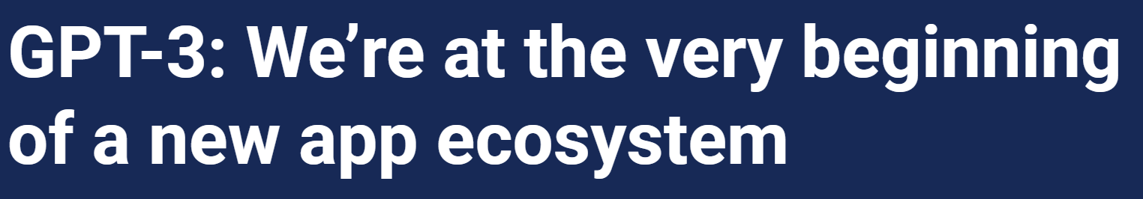
OpenAI buzz
How the tech behind ChatGPT could change the world—an updated episode from our archive | The Economist
Microsoft Bets Big on the Creator of ChatGPT in Race to Dominate A.I. - The New York Times (nytimes.com)
OpenAI’s ChatGPT is a fascinating glimpse into the scary power of AI - Vox
dall-e | TechCrunch
GPT-3: We’re at the very beginning of a new app ecosystem | VentureBeat
A.I. Can Now Write Its Own Computer Code. That’s Good News for Humans. - The New York Times (nytimes.com)

Slide 4


Microsoft and OpenAI partnership
Ensure that artificial general intelligence (AGI) benefits humanity
Empower every person and organization on the planet to achieve more
GPT-3.5 and GPT-4
ChatGPT
Codex
DALL·E 2 (preview)
Text
Conversation
Code
Images
Notes:
Narrative/talk track:
The MSFT / OpenAI partnership and how we collaborate
Microsoft has formed a partnership with OpenAI to collaborate on the development of artificial intelligence technologies. The partnership aims to accelerate the development of advanced AI systems and bring the benefits of AI to more people.
As part of the partnership, Microsoft and OpenAI have agreed to work together on several key areas, including:
Developing AI technologies: The two companies will collaborate on the development of new AI models and algorithms, with a focus on natural language processing, computer vision, and other areas of AI.
Building an AI computing platform: Microsoft and OpenAI will work together to build a new AI computing platform that will allow developers to easily access and use advanced AI models and algorithms.
Advancing AI research: The two companies will also collaborate on a range of research projects aimed at advancing the state of the art in AI.
Making AI more accessible: The partnership aims to make AI more accessible to a wider range of developers and organizations, in order to bring the benefits of AI to more people.
Microsoft has also announced it will use OpenAI's GPT-3 technology to add more capabilities to its products such as Cortana, Power Virtual Agents and Dynamics 365.
Additionally, Microsoft has also made an investment in OpenAI, allowing the company to use Microsoft Azure as its preferred cloud platform, and allowing OpenAI to tap into the vast resources of Microsoft to accelerate its research. This partnership gives OpenAI the ability to scale its models and services on Azure and make them more widely available to customers.
Overall, the partnership between Microsoft and OpenAI aims to accelerate the development and use of advanced AI technologies, with a focus on making AI more accessible to developers and organizations, in order to bring the benefits of AI to more people.

Slide 5

Generative AI
Content creation by API
Prompt
Write a tagline for an ice cream shop.
Prompt
I’m having trouble getting my Xbox to turn on.
Prompt
Table customers, columns = [CustomerId, FirstName, LastName, Company, Address, City, State, Country, PostalCode]
Create a SQL query for all customers in Texas named Jane
query =
Prompt
A ball of fire with vibrant colors to show the speed of innovation at our media and entertainment company
Response
There are a few things you can try to troubleshoot this issue … …
Response
We serve up smiles with every scoop!
Response
Prompt
Thanks! That worked. What games do you recommend for my 14-year-old?
Response
SELECT *
FROM customers
WHERE State = 'TX' AND FirstName = 'Jane'
Response
Here are a few games that you might consider: …
Notes:
This slide shows three simple examples of how the Azure OpenAI Service allows you to generate content using the API.
You can build prompts that ask it to generate text, database queries, or images.
Now where the real magic can happen is when you customize Azure OpenAI with your business data.

Slide 6

















Azure AI
Applications
Partner Solutions
Business Users
Application Platform
AI Builder
Power BI
Power Apps
Power Automate
Power Virtual Agents
Scenario-Based Services
Applied AI Services
Bot Service
Cognitive Search
Form Recognizer
Video Indexer
Metrics Advisor
Immersive Reader
Customizable AI Models
Cognitive Services
Developers & Data Scientists
Vision
Speech
Language
Decision
OpenAI Service
ML Platform
Azure Machine Learning

Slide 7

Azure OpenAI Service
Deployed within your Azure subscription, secured by you, accessed only by you, and tied to your datasets and applications
Large, pretrained AI models to unlock new scenarios
GPT-3
Codex
Custom AI models fine-tuned with your data and hyperparameters
DALL·E (preview)
Built-in responsible AI to detect and mitigate harmful use
Enterprise-grade security with role-based access control (RBAC) and private networks

Slide 8
Azure OpenAI | Capabilities
Subject Research
Creative Ideation
Essay outlines
Extracting insights
Semantic search
Summarizing text
Code generation
Limitless generation with a few lines of input
Dialog agents
Virtual Assistants
Language Translation
Writing assistance
Classifying text
Answering questions
Poem creation
Comments from code
Image Generation
Code refactoring

Slide 9


Azure OpenAI | Top 4 Capabilities & Use Cases
Content Generation
Summarization
Code
generation
Semantic Search
Call Center Analytics: Automatically generate responses to customer inquiries
Call Center Analytics: Summary of customer support conversation logs
Convert Natural Language to SQL (or vice versa) for telemetry data
Search reviews for a specific product / service
Generate personalised UI for your website
Subject Matter Expert Document Summarization (e.g. financial reporting, analyst articles)
Convert Natural Language to Query Proprietary Data Models
Information Discovery and Knowledge Mining
Social Media Trends Summarization
Code Documentation
Examples of Multiple Model Use Cases
End to End Call Center Analytics: Classification, Sentiment, Entity Extraction, Summarization and Email Generation
Customer 360: Hyper-personalisation using timely Summarization of customer queries & trends, Search, and Content Generation
Business Process Automation: Search through structured & unstructured documentation, Generate Code to query data models, Content Generation

Slide 10






Document Process Automation
Extract rich insights from documents and summarizing them
Cosmos DB
PDF OCR pipeline
Web Application
Documents
Azure Form Recognizer
Azure Cognitive Search
Power BI
Azure OpenAI Service

Slide 11





Contact Center Analytics using Speech API & OpenAI
Extract rich insights from call transcripts
PowerBI Insights (near real-time)
Caller
Intelligent Transcription
Conversation Trends & Insights
Person-to-Person Conversation
Audio Files
Telephony Server
Azure Storage
Speech-to-Text
Azure OpenAI Service
CRM
Azure Cognitive Services –
Speech & OpenAI
Call-Center Agent
Detailed call history incl. summaries, call reasons, etc.

Slide 12
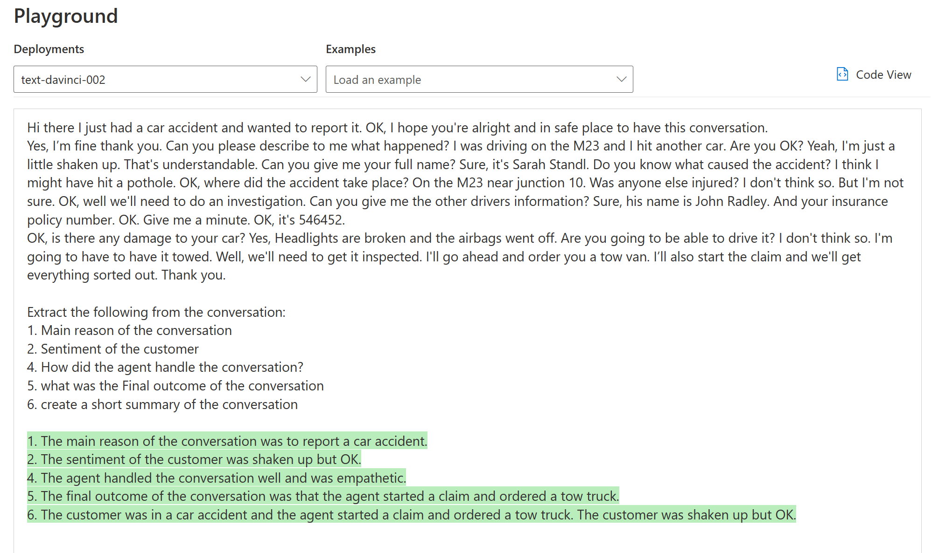
Azure OpenAI | Sample Use Cases
Customer conversation
Example:
Extract information from text and summarize it
Azure OpenAI Instruction
Output

Slide 13
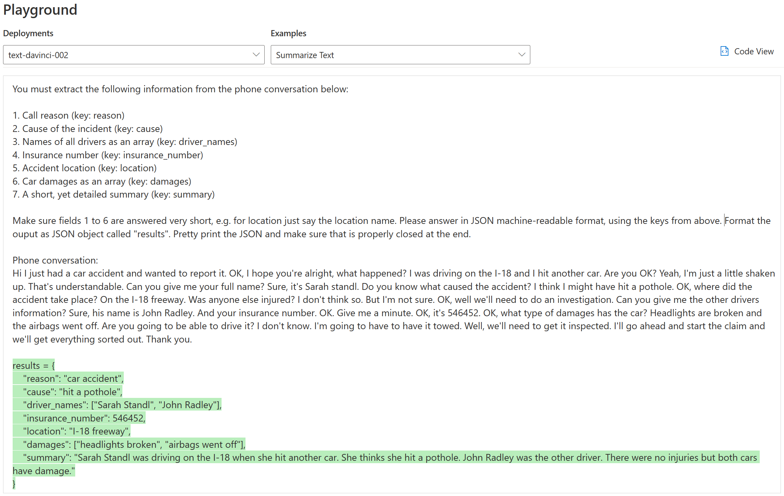
Call Center Automation Example: OpenAI Prompt
Azure OpenAI | Sample Use Cases
Azure OpenAI Instruction in English
Customer conversation in English (or other language)
Output as JSON

Slide 14
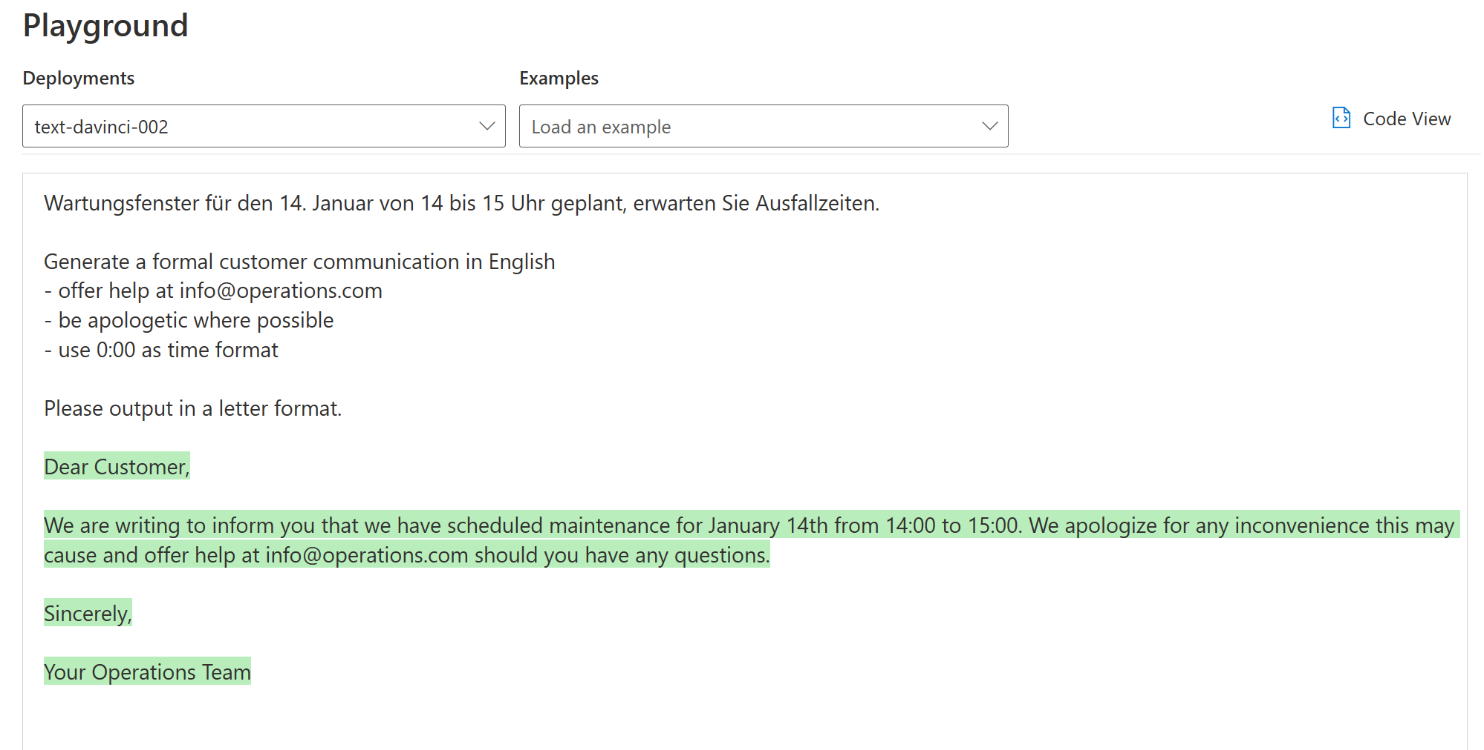
Azure OpenAI | Sample Use Cases (cont.)
Input - German
Example:
Generate auto text in any language
Azure OpenAI Instruction - English
Output - English

Slide 15
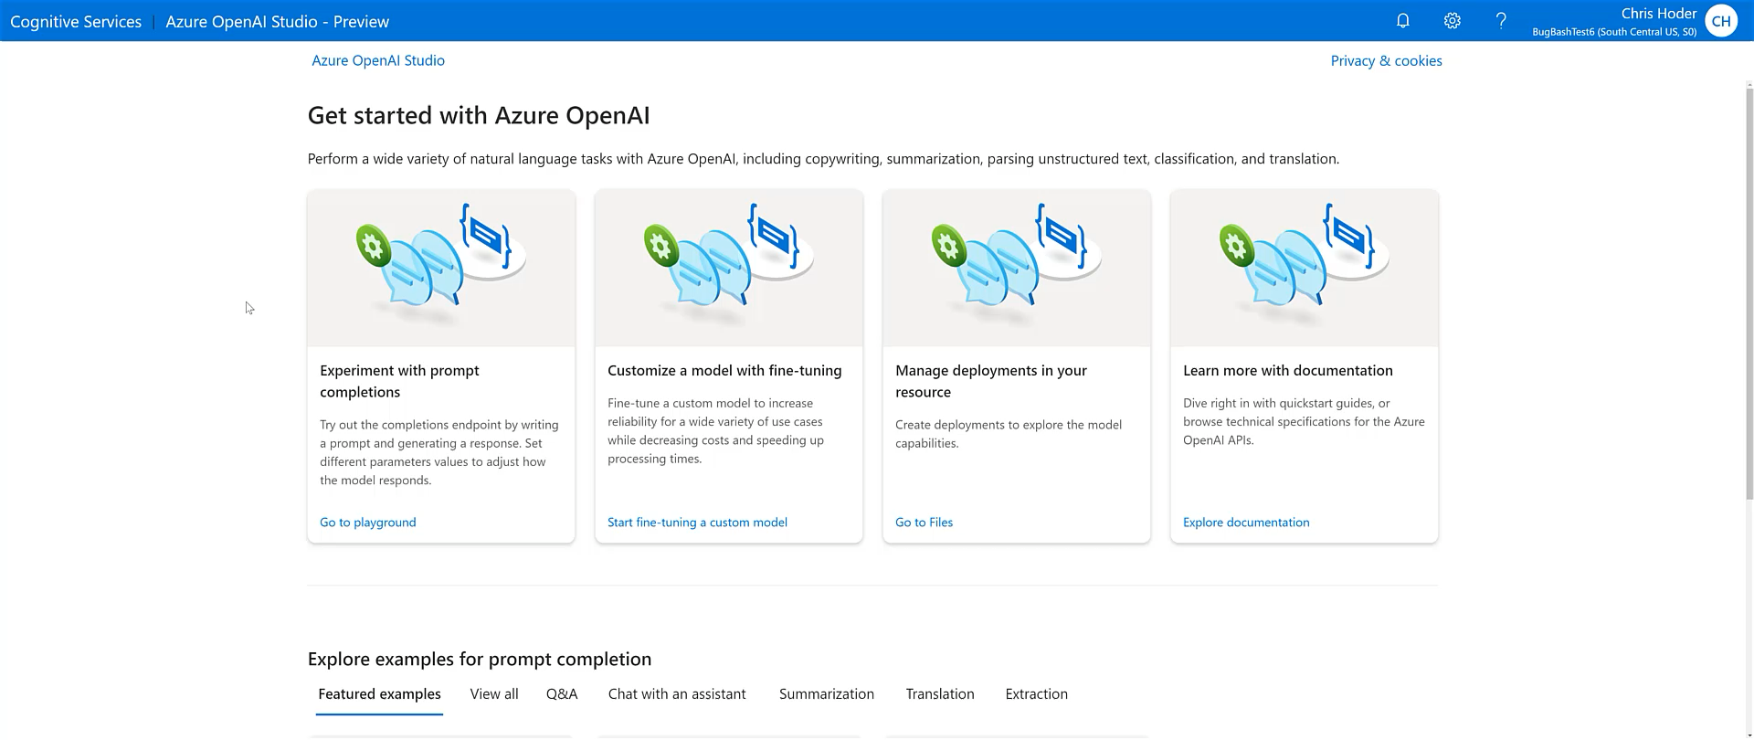
Azure OpenAI | Demo
2 min demo
Enabling all skill levels to build prototypes easily and explore the art of possible

Slide 16


Carmax case study
Produced 11 years' worth of car summaries in a matter of Months

Slide 17
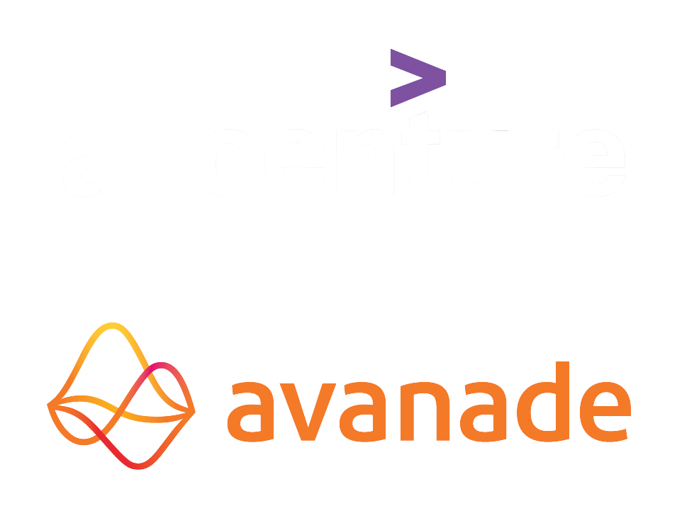



































Customer Momentum

Slide 18






Azure OpenAI | Considerations
I need a general-purpose model that can handle multiple tasks.
e.g. translation+entity recognition+sentiment analysis
I need to generate human-like content, whilst preserving data privacy and security
e.g., abstractive summarization, content writing, paraphrasing, code
I need rapid prototyping and quick time to market for many use cases
I could use a model with little or no training
I want to explore solutions / use cases that have been described previously
Vision
Speech
OpenAI Service
Language
Decision
Azure AI Cognitive Services

Slide 19
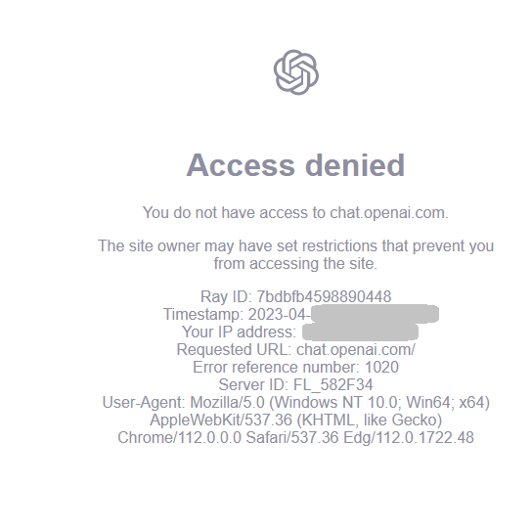
OpenAI
With Azure, you can use Azure OpenAI without VPN

Slide 20


Key takeaway: Azure OpenAI Is OpenAI For The Enterprise
Feature | OpenAI | Azure OpenAI
Security & Data Privacy | Basic Security | Enterprise Security, RBAC, Customer-Managed Keys
Compliance | Limited | SOC2, ISO, HIPAA, CSA STAR
Reliability | Limited | Azure SLA, Dedicated Capacity Option (TBD)
Responsible AI | Separate Safety Classifier (adds latency) | Built-in, enterprise-grade, low latency moderation and harm prevention
Holistic Solution | Advanced LLM & Image Generation, Basic Speech | OpenAI Models, Complete AI Solution, and a Complete PaaS
Region availability: East US, South Central US, West Europe, France Central (as of Jun 2023)

Slide 21
Azure OpenAI | Benefits
Increased efficiency and productivity by getting more done in lesser time through rapid prototyping and quicker time to market*
Faster time to realize value
Enhanced customer experience with a greater focus on customer-centric services and products, whilst utilizing feedback and trends better
Easy to use: Even entry level data scientists or business users can use Azure OpenAI Service Playground
Ensure data privacy & security, and implement it in a responsible manner using a Trusted Cloud Provider
Does not require a long tedious annotation process*
Less training data is required for many relevant use cases*
Ability to perform text analytics and generation tasks that up until now were reserved only to humans
* in most relevant use cases observed

Slide 22
Next steps
To learn more, please visit Azure OpenAI Service’s product page.
Have a use case? Speak to your Specialist / AE and sign up for access here:
GPT 3.5 & ChatGPT - https://aka.ms/oai/access
GPT-4 (dependency on GPT 3.5 access) - https://aka.ms/oai/get-gpt4
MCPP Data & AI landing page
¹General guidance is to start with Davinci and then go down to see if a less sophisticated model can repeat the same results

Slide 23
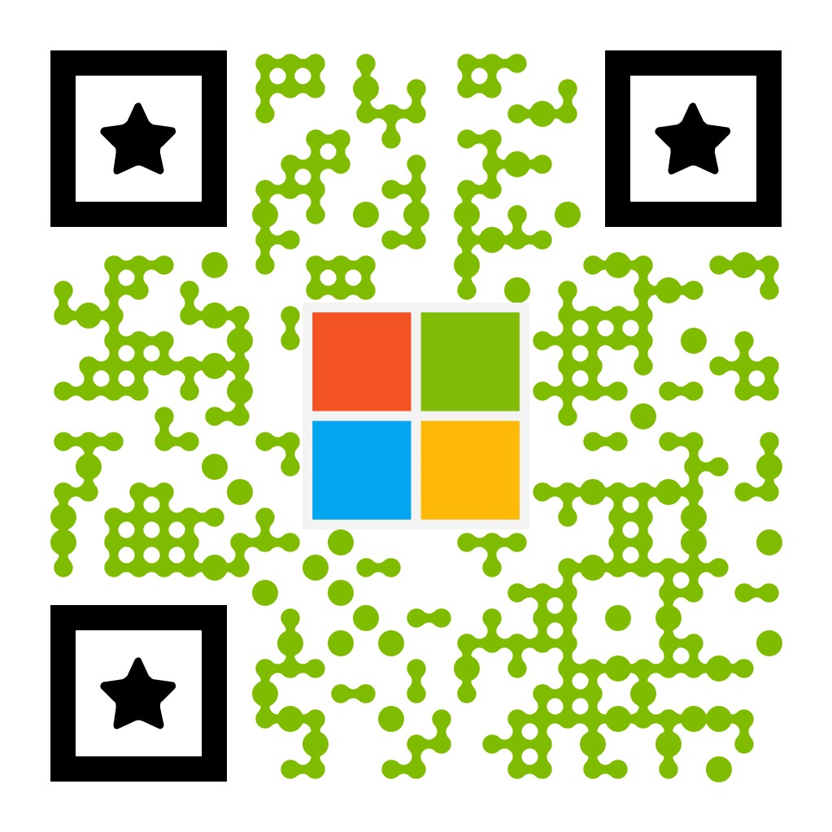
Update – Coming Soon
Bookmark ‘what's new’ in Azure OpenAI Service
Sign up for Azure OpenAI Service updates
Azure OpenAI Service
GPT-3 (GA)
DALL·E 2 (preview)
ChatGPT (GA)
GPT-4 (GA)
Apply your own data
Plugins for Azure OpenAI Service
Configurable Content Filters
Provisioned Throughput
Coming soon

Slide 24
Thank you

Slide 25

Microsoft AI

